Slide 1
UML Sistem Akademik
Febrie Ahmad Azizi, Ridlo Wahyudi Wibowo

Slide 2
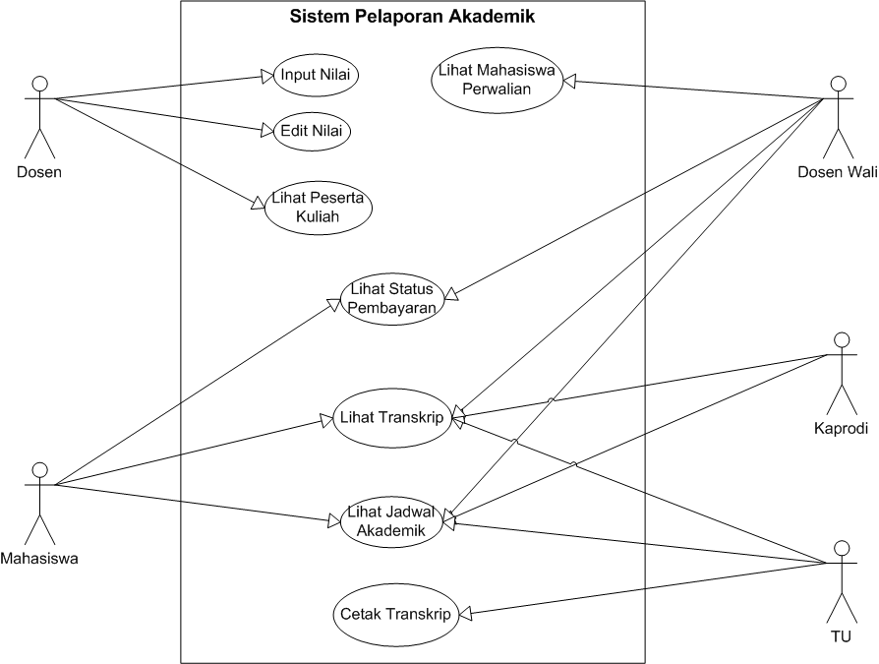
Use Case

Slide 3
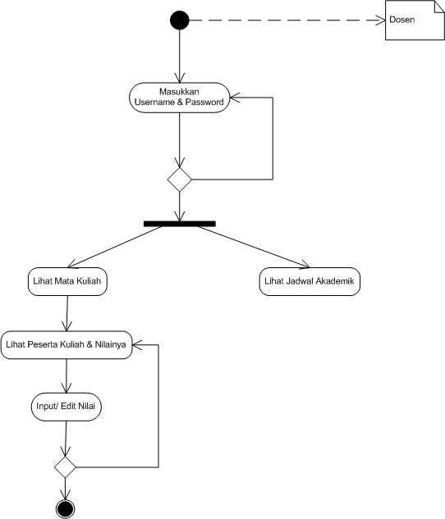
Activity : Dosen Input/Edit Nilai

